Slide 1
Pointer, Dinamik Bellek ve Diziler

Slide 2
Dinamik Hafıza Tahsisi
Standart kütüphanedeki malloc(), calloc(), realloc(), free() fonksiyonları ile program dinamik olarak bellek alanı isteyebilir.
İstenen belleğin başlangıç adresi bir işaretçide tutularak ile bu bellek üzerinde işlem yapılır.
void* malloc(boyut)
  boyut byte kadar yeni bellek alanı ayırır.
void* calloc(adet, boyut)
  boyut*adet byte kadar yeni bellek alanı ayırır.
void* realloc(işaretçi, boyut)
  işaretçi tarafından işaret edilen bellek alanını boyut byte kadar olacak şekilde değiştirir.
free(işaretçi)
  işaretçi için ayrılan bellek alanı geri verilir.

Slide 3
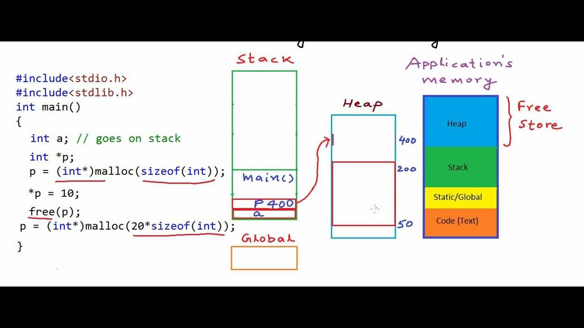
malloc fonksiyonu
malloc fonksiyonu programın çalışma zamanı sırasında bellekten dinamik bir blok elde etmek için kullanılır. Fonksiyonun stdlib.h başlık dosyası içindeki bildirimi aşağıdaki gibidir:
void *malloc(size_t nbyte);
size_t türünün derleyiciyi yazanların seçimine bağlı olarak unsigned int ya da unsigned long türlerinden birinin yeni tür ismi olarak tanımlanması gerektiğini, ve sistemlerin hemen hemen hepsinde size_t türünün unsigned int türü olduğunu hatırlayalım.
Fonksiyona gönderilecek arguman ayrılmak istenen bloğun byte olarak uzunluğudur. Ayrılan alanın sürekli (contigious) olması garanti altına alınmıştır. malloc fonksiyonunun geri dönüş değeri elde edilen bellek bloğunun başlangıç adresidir.

Slide 4
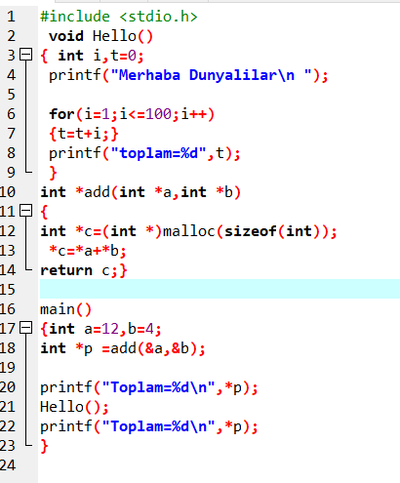
Malloc
Notes:
#include <stdio.h>
#include <stdlib.h>
void Hello()
{int i, t=0;
printf("\n Merhabalar ");
for (i=1;i<=100;i++)
t=t+i;
printf("\n toplam=%d", t);}
int *add (int *a, int *b)
{ int *c=(int *) malloc (sizeof(int));
*c= *a+*b;
return c;}
main()
{ int a=12, b=4;
int *p=add(&a,&b);
printf(" \n Toplam=%d", *p);
Hello();
printf(" \n Toplam=%d", *p);
}

Slide 5
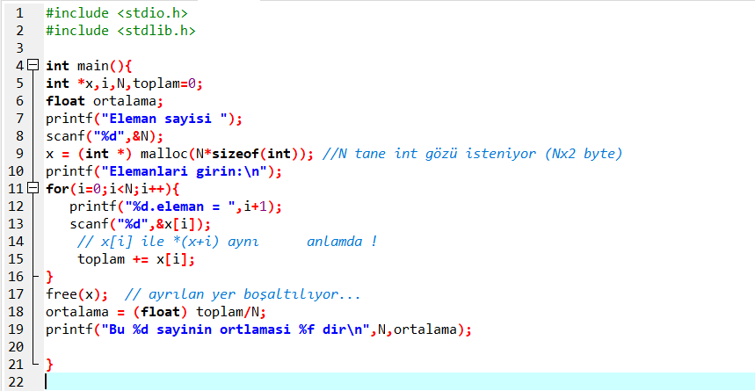

Slide 6

#include <stdio.h>
#include <stdlib.h>
int main(){
int *x,i,N,toplam=0;
float ortalama;
printf("Eleman sayisi ");
scanf("%d",&N);
x = (int *) malloc(N*sizeof(int));
printf("adres=%p\n",x);
printf("Elemanlari girin:\n");
for(i=0;i<N;i++){
printf("%d.eleman adresi:%p = ",i+1,x+i);
scanf("%d",&x[i]);
// x[i] ile *(x+i) aynı anlamda !
toplam += x[i];
}
free(x); // ayrılan yer boşaltılıyor...
ortalama = (float) toplam/N;
printf("Bu %d sayinin ortlamasi %f dir\n",N,ortalama);
}
Notes:
#include <stdio.h>
#include <stdlib.h>
int main(){
int *x,i,N,toplam=0;
float ortalama;
printf("Eleman sayisi ");
scanf("%d",&N);
x = (int *) malloc(N*sizeof(int));
printf("adres=%p\n",x);
printf("Elemanlari girin:\n");
for(i=0;i<N;i++){
printf("%d.eleman adresi:%p = ",i+1,x+i);
scanf("%d",&x[i]);
// x[i] ile *(x+i) aynı anlamda !
toplam += x[i];
}
free(x); // ayrılan yer boşaltılıyor...
ortalama = (float) toplam/N;
printf("Bu %d sayinin ortlamasi %f dir\n",N,ortalama);
}

Slide 7
20 elemanlı diziyi rasgele üreten, görüntüleyen ve sıralayan programı yapınız.
Çözüm: Slayt Notlar kısmında.
Notes:
#include<stdio.h>
#include<stdlib.h>
#include<time.h>
#define N 20
void print_array(int *,int );
int *array;
//random sayi uretme fonksiyonu
int rand_dizi_uret(){
array=(int *)malloc(sizeof(int)*N);
//uretilen sayi 0 -20 arasi olsun
int i;
for(i=0; i<N; i++){
array[i] = 0+rand()%20;
}
printf("Uretilen Dizi:\n------\n");
print_array(array,N);
}
void print_array(int *dizi,int len){
int i;
for(i=0 ; i<len ; i++ )
printf(" %d ",dizi[i]);
printf("\n");
}
//swap fonksiyonu
void swap(int *xp, int *yp){
int temp = *xp;
*xp = *yp;
*yp = temp;
}
//Siralama fonksiyonu
void sirala(){
int i,j;
for( i=0; i< N-1; i++)
for ( j=0; j<N-i-1; j++)
if (array[j] > array[j+1])
swap(&array[j], &array[j+1]);
printf("Siralanmis_dizi:\n------\n");
print_array(array,N);
}
int main(){
srand(time(NULL));
rand_dizi_uret();
sirala();
}

Slide 8
Fonksiyon İşaretçileri
Fonksiyon işaretçileri, işaretçi (pointer) kavramının gücünü gösteren diğer bir uygulama alanıdır.
Dizilerde olduğu gibi, fonksiyon adları da sabit işaretçidir.
Fonksiyon kodlarının bellekte bir adreste tutulduğu şeklinde düşünebiliriz.
Fonksiyon işaretçisi basit olarak fonksiyon adının saklandığı bellek adresini tutan bir işaretçidir.
Fonksiyon işaretçileri sayesinde, fonksiyonlar başka fonksiyonlara parametre olarak aktarılabilmektedirler.

Slide 9
#include <stdio.h>
int* buyuk(int*, int*);
void main()
{
int numa=0;
int numb=0;
int *result;
printf(" birinci deger: ");
scanf("%d", &numa);
printf(" ikinci deger : ");
scanf("%d", &numb);
result=buyuk(&numa, &numb);
printf(" buyuk olan %d \n\n",*result);
}
int* buyuk(int *n1, int *n2)
{
if(*n1 > *n2)
return n1;
else
return n2;
}

Slide 10
#include <stdio.h>
int buyuk(int, int);
void main()
{
int numa=0;
int numb=0;
int result;
printf(" birinci deger: ");
scanf("%d", &numa);
printf(" ikinci deger : ");
scanf("%d", &numb);
result=buyuk(numa, numb);
printf(" buyuk olan %d \n\n",result);
}
int buyuk(int n1, int n2)
{
if(n1 > n2)
return n1;
else
return n2;
}

Slide 11
Fonksiyonları Gösteren Göstericiler
Bir fonksiyonu gösteren gösterici
  Fonksiyonunun adresini tutar.
  Bir dizi isminin ilk elemanın adresi olmasına benzer.
  Fonksiyon isimleri, fonksiyonun görevini yapan kodun hafızadaki başlangıç adresidir.
Fonksiyonları gösteren göstericiler
  Fonksiyonlara geçirilebilir.
  Fonksiyonlardan geri döndürülebilir.
  Fonksiyon gösteren diğer göstericilere atanabilir.

Slide 12
Fonksiyon İşaretçileri (devam…)
Fonksiyonların bellekteki adresleri aşağıdaki kodlama kullanımıyla öğrenilebilir:
int f(int); /* fonksiyon bildirimi */
int (*pf)(int); /*fonksiyon işaretçi bild.*/
pf = &f; /*f'nin adresini pf'ye ata! */

Slide 13
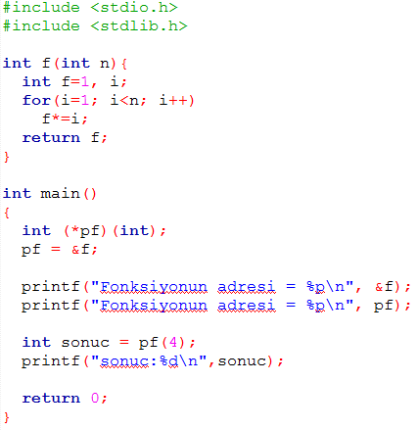

Örnek: Fonksiyon İşaretçileri

Slide 14
#include <stdio.h>
void yazdir(int,int,int(*)(int,int));
int kucuk(int,int);
int buyuk(int,int);
int main()
{
int a,b,secim;
printf("Iki tamsayi giriniz: ");
scanf("%d%d",&a,&b);
printf("Buyuk olani bulmak icin 1"
" kucuk olani bulmak icin 2 giriniz: ");
scanf("%d",&secim);
if(secim==1) yazdir(a,b,buyuk);
else yazdir(a,b,kucuk);
};
}
void yazdir(int a,int b,int(*k)(int,int))
{
int sonuc=0;
sonuc=(*k)(a,b);
printf("Sonuc: %d",sonuc);
}
int kucuk(int a,int b)
{
if(a<b) return a;
else return b ;
}
int buyuk(int a,int b)
{
if(a>b) return a;
else return b ;
}
Notes:
#include <stdio.h>
void yazdir(int,int,int(*)(int,int));
int kucuk(int,int);
int buyuk(int,int);
int main()
{
int a,b,secim;
printf("Iki tamsayi giriniz: ");
scanf("%d%d",&a,&b);
printf("Buyuk olani bulmak icin 1"
" kucuk olani bulmak icin 2 giriniz: ");
scanf("%d",&secim);
if(secim==1) yazdir(a,b,buyuk);
else yazdir(a,b,kucuk);
}
void yazdir(int a,int b,int(*k)(int,int))
{
int sonuc=0;
sonuc=(*k)(a,b);
printf("Sonuc: %d",sonuc);
}
int kucuk(int a,int b)
{
if(a<b) return a;
else return b ;
}
int buyuk(int a,int b)
{
if(a>b) return a;
else return b ;
}

Slide 15
Using the const Qualifier with Pointers
const qualifier
  Variable cannot be changed
  Use const if function does not need to change a variable
  Attempting to change a const variable produces an error
const pointers
  Point to a constant memory location
  Must be initialized when declared
  int *const myPtr = &x;
    Type int *const – constant pointer to an int
  const int *myPtr = &x;
    Regular pointer to a const int
  const int *const Ptr = &x;
    const pointer to a const int
    x can be changed, but not *Ptr

Slide 16
1 /* Fig. 7.13: fig07_13.c
2 Attempting to modify a constant pointer to
3 non-constant data */
4
1. Declare variables
1.1 Declare const pointer to an int
2. Change *ptr (which is x)
2.1 Attempt to change ptr
3. Output
Program Output
5 #include <stdio.h>
6
7 int main()
8 {
Changing *ptr is allowed – x is not a constant.
9 int x, y;
10
11 int * const ptr = &x; /* ptr is a constant pointer to an
12 integer. An integer can be modified
13 through ptr, but ptr always points
14 to the same memory location. */
15 *ptr = 7;
Changing ptr is an error – ptr is a constant pointer.
16 ptr = &y;
17
18 return 0;
19 }
FIG07_13.c:
Error E2024 FIG07_13.c 16: Cannot modify a const object in
function main
*** 1 errors in Compile ***

Slide 17
Bubble Sort Using Call-by-reference
https://www.youtube.com/watch?v=9szGvK1Wo34
Implement bubblesort using pointers
  Swap two elements
  swap function must receive address (using &) of array elements
    Array elements have call-by-value default
  Using pointers and the * operator, swap can switch array elements
Psuedocode
    Initialize array
    print data in original order
    Call function bubblesort
    print sorted array
    Define bubblesort

Slide 18
7.6 Bubble Sort Using Call-by-reference
sizeof
  Returns size of operand in bytes
  For arrays: size of 1 element * number of elements
  if sizeof( int ) equals 4 bytes, then
      int myArray[ 10 ];
      printf( "%d", sizeof( myArray ) );
    will print 40
sizeof can be used with
  Variable names
  Type name
  Constant values

Slide 19
1 /* Fig. 7.15: fig07_15.c
2 This program puts values into an array, sorts the values into
3 ascending order, and prints the resulting array. */
4 #include <stdio.h>
1. Initialize array
1.1 Declare variables
2. Print array
2.1 Call bubbleSort
2.2 Print array
5 #define SIZE 10
6 void bubbleSort( int *, const int );
7
8 int main()
9 {
10
11 int a[ SIZE ] = { 2, 6, 4, 8, 10, 12, 89, 68, 45, 37 };
12 int i;
Bubblesort gets passed the address of array elements (pointers). The name of an array is a pointer.
13
14 printf( "Data items in original order\n" );
15
16 for ( i = 0; i < SIZE; i++ )
17 printf( "%4d", a[ i ] );
18
19 bubbleSort( a, SIZE ); /* sort the array */
20 printf( "\nData items in ascending order\n" );
21
22 for ( i = 0; i < SIZE; i++ )
23 printf( "%4d", a[ i ] );
24
25 printf( "\n" );
26
27 return 0;
28 }
29
30 void bubbleSort( int *array, const int size )
31 {
32 void swap( int *, int * );

Slide 20
33 int pass, j;
34 for ( pass = 0; pass < size - 1; pass++ )
35
36 for ( j = 0; j < size - 1; j++ )
3. Function definitions
Program Output
37
38 if ( array[ j ] > array[ j + 1 ] )
39 swap( &array[ j ], &array[ j + 1 ] );
40 }
41
42 void swap( int *element1Ptr, int *element2Ptr )
43 {
44 int hold = *element1Ptr;
45 *element1Ptr = *element2Ptr;
46 *element2Ptr = hold;
47 }
Data items in original order
2 6 4 8 10 12 89 68 45 37
Data items in ascending order
2 4 6 8 10 12 37 45

Slide 21
7.9 Arrays of Pointers
Arrays can contain pointers
For example: an array of strings
    char *suit[ 4 ] = { "Hearts", "Diamonds",
    "Clubs", "Spades" };
  Strings are pointers to the first character
  char * – each element of suit is a pointer to a char
  The strings are not actually stored in the array suit, only pointers to the strings are stored
  suit array has a fixed size, but strings can be of any size
suit[0]
’H’
’e’
’a’
’r’
’t’
’s’
’\0’
suit[1]
’D’
’i’
’a’
’m’
’o’
’n’
’d’
’s’
’\0’
suit[2]
’C’
’l’
’u’
’b’
’s’
’\0’
suit[3]
’S’
’p’
’a’
’d’
’e’
’s’
’\0’

Slide 22
7.10 Case Study: A Card Shuffling and Dealing Simulation
Card shuffling program
  Use array of pointers to strings
  Use double scripted array (suit, face)
  The numbers 1-52 go into the array
    Representing the order in which the cards are dealt
Ace
Two
Three
Four
Five
Six
Seven
Eight
Nine
Ten
Jack
Queen
King
0
1
2
3
4
5
6
7
8
9
10
11
12
Hearts
0
Diamonds
1
Clubs
2
Spades
3
deck[ 2 ][ 12 ] represents the King of Clubs
Clubs
King

Slide 23
7.10 Case Study: A Card Shuffling and Dealing Simulation
Pseudocode
  Top level:
    Shuffle and deal 52 cards
  First refinement:
    Initialize the suit array
    Initialize the face array
    Initialize the deck array
    Shuffle the deck
    Deal 52 cards

Slide 24
7.10 Case Study: A Card Shuffling and Dealing Simulation
  Second refinement
    Convert shuffle the deck to
      For each of the 52 cards
      Place card number in randomly selected unoccupied slot of deck
    Convert deal 52 cards to
      For each of the 52 cards
      Find card number in deck array and print face and suit of card

Slide 25
7.10 Case Study: A Card Shuffling and Dealing Simulation
  Third refinement
    Convert shuffle the deck to
      Choose slot of deck randomly
      While chosen slot of deck has been previously chosen
      Choose slot of deck randomly
        Place card number in chosen slot of deck
    Convert deal 52 cards to
      For each slot of the deck array
      If slot contains card number
      Print the face and suit of the card

Slide 26
1 /* Fig. 7.24: fig07_24.c
2 Card shuffling dealing program */
3 #include <stdio.h>
4 #include <stdlib.h>
5 #include <time.h>
1. Initialize suit and face arrays
1.1 Initialize deck array
2. Call function shuffle
2.1 Call function deal
3. Define functions
6
7 void shuffle( int [][ 13 ] );
8 void deal( const int [][ 13 ], const char *[], const char *[] );
9
10 int main()
11 {
12 const char *suit[ 4 ] =
13 { "Hearts", "Diamonds", "Clubs", "Spades" };
14 const char *face[ 13 ] =
15 { "Ace", "Deuce", "Three", "Four",
16 "Five", "Six", "Seven", "Eight",
17 "Nine", "Ten", "Jack", "Queen", "King" };
18 int deck[ 4 ][ 13 ] = { 0 };
19
20 srand( time( 0 ) );
21
22 shuffle( deck );
23 deal( deck, face, suit );
24
25 return 0;
26 }
27
28 void shuffle( int wDeck[][ 13 ] )
29 {
30 int row, column, card;
31
32 for ( card = 1; card <= 52; card++ ) {
Notes:
/* Fig. 7.24: fig07_24.c
Card shuffling dealing program */
#include <stdio.h>
#include <stdlib.h>
#include <time.h>
void shuffle( int [][ 13 ] );
void deal( const int [][ 13 ], const char *[], const char *[] );
int main()
{
const char *suit[ 4 ] =
{ "Hearts", "Diamonds", "Clubs", "Spades" };
const char *face[ 13 ] =
{ "Ace", "Deuce", "Three", "Four",
"Five", "Six", "Seven", "Eight",
"Nine", "Ten", "Jack", "Queen", "King" };
int deck[ 4 ][ 13 ] = { 0 };
srand( time( 0 ) );
shuffle( deck );
deal( deck, face, suit );
return 0;
}
void shuffle( int wDeck[][ 13 ] )
{
int row, column, card;
for ( card = 1; card <= 52; card++ ) {
do {
row = rand() % 4;
column = rand() % 13;
} while( wDeck[ row ][ column ] != 0 );
wDeck[ row ][ column ] = card;
}
}
void deal( const int wDeck[][ 13 ], const char *wFace[],
const char *wSuit[] )
{
int card, row, column;
for ( card = 1; card <= 52; card++ )
for ( row = 0; row <= 3; row++ )
for ( column = 0; column <= 12; column++ )
if ( wDeck[ row ][ column ] == card )
printf( "%5s of %-8s%c",
wFace[ column ], wSuit[ row ],
card % 2 == 0 ? '\n' : '\t' );
}

Slide 27
33 do {
The numbers 1-52 are randomly placed into the deck array.
34 row = rand() % 4;
35 column = rand() % 13;
36 } while( wDeck[ row ][ column ] != 0 );
3. Define functions
37
38 wDeck[ row ][ column ] = card;
39 }
40 }
41
42 void deal( const int wDeck[][ 13 ], const char *wFace[],
43 const char *wSuit[] )
44 {
45 int card, row, column;
46
47 for ( card = 1; card <= 52; card++ )
48
Searches deck for the card number, then prints the face and suit.
49 for ( row = 0; row <= 3; row++ )
50
51 for ( column = 0; column <= 12; column++ )
52
53 if ( wDeck[ row ][ column ] == card )
54 printf( "%5s of %-8s%c",
55 wFace[ column ], wSuit[ row ],
56 card % 2 == 0 ? '\n' : '\t' );
57 }

Slide 28
Six of Clubs Seven of Diamonds
Ace of Spades Ace of Diamonds
Ace of Hearts Queen of Diamonds
Queen of Clubs Seven of Hearts
Ten of Hearts Deuce of Clubs
Ten of Spades Three of Spades
Ten of Diamonds Four of Spades
Four of Diamonds Ten of Clubs
Six of Diamonds Six of Spades
Eight of Hearts Three of Diamonds
Nine of Hearts Three of Hearts
Deuce of Spades Six of Hearts
Five of Clubs Eight of Clubs
Deuce of Diamonds Eight of Spades
Five of Spades King of Clubs
King of Diamonds Jack of Spades
Deuce of Hearts Queen of Hearts
Ace of Clubs King of Spades
Three of Clubs King of Hearts
Nine of Clubs Nine of Spades
Four of Hearts Queen of Spades
Eight of Diamonds Nine of Diamonds
Jack of Diamonds Seven of Clubs
Five of Hearts Five of Diamonds
Four of Clubs Jack of Hearts
Jack of Clubs Seven of Spades
Program Output

Slide 29
7.11 Pointers to Functions
Pointer to function
  Contains address of function
  Similar to how array name is address of first element
  Function name is starting address of code that defines function
Function pointers can be
  Passed to functions
  Stored in arrays
  Assigned to other function pointers

Slide 30
7.11 Pointers to Functions
Example: bubblesort
  Function bubble takes a function pointer
    bubble calls this helper function
    this determines ascending or descending sorting
  The argument in bubblesort for the function pointer:
      bool ( *compare )( int, int )
    tells bubblesort to expect a pointer to a function that takes two ints and returns a bool
  If the parentheses were left out:
      bool *compare( int, int )
    Declares a function that receives two integers and returns a pointer to a bool

Slide 31
1 /* Fig. 7.26: fig07_26.c
2 Multipurpose sorting program using function pointers */
3 #include <stdio.h>
4 #define SIZE 10
1. Initialize array
2. Prompt for ascending or descending sorting
2.1 Put appropriate function pointer into bubblesort
2.2 Call bubble
3. Print results
5 void bubble( int [], const int, int (*)( int, int ) );
6 int ascending( int, int );
7 int descending( int, int );
Notice the function pointer parameter.
8
9 int main()
10 {
11
12 int order,
13 counter,
14 a[ SIZE ] = { 2, 6, 4, 8, 10, 12, 89, 68, 45, 37 };
15
16 printf( "Enter 1 to sort in ascending order,\n"
17 "Enter 2 to sort in descending order: " );
18 scanf( "%d", &order );
19 printf( "\nData items in original order\n" );
20
21 for ( counter = 0; counter < SIZE; counter++ )
22 printf( "%5d", a[ counter ] );
23
24 if ( order == 1 ) {
25 bubble( a, SIZE, ascending );
26 printf( "\nData items in ascending order\n" );
27 }
28 else {
29 bubble( a, SIZE, descending );
30 printf( "\nData items in descending order\n" );
31 }
32
Notes:
/* Fig. 7.26: fig07_26.cpp
Multipurpose sorting program using function pointers */
#include <stdio.h>
#define SIZE 10
void bubble( int [], const int, int (*)( int, int ) );
int ascending( int, int );
int descending( int, int );
int main()
{
int order,
counter,
a[ SIZE ] = { 2, 6, 4, 8, 10, 12, 89, 68, 45, 37 };
printf( "Enter 1 to sort in ascending order,\n"
"Enter 2 to sort in descending order: " );
scanf( "%d", &order );
printf( "\nData items in original order\n" );
for ( counter = 0; counter < SIZE; counter++ )
printf( "%5d", a[ counter ] );
if ( order == 1 ) {
bubble( a, SIZE, ascending );
printf( "\nData items in ascending order\n" );
}
else {
bubble( a, SIZE, descending );
printf( "\nData items in descending order\n" );
}
for ( counter = 0; counter < SIZE; counter++ )
printf( "%5d", a[ counter ] );
printf( "\n" );
return 0;
}
void bubble( int work[], const int size,
int (*compare)( int, int ) )
{
int pass, count;
void swap( int *, int * );
for ( pass = 1; pass < size; pass++ )
for ( count = 0; count < size - 1; count++ )
if ( (*compare)( work[ count ], work[ count + 1 ] ) )
swap( &work[ count ], &work[ count + 1 ] );
}
void swap( int *element1Ptr, int *element2Ptr )
{
int temp;
temp = *element1Ptr;
*element1Ptr = *element2Ptr;
*element2Ptr = temp;
}
int ascending( int a, int b )
{
return b < a; /* swap if b is less than a */
}
int descending( int a, int b )
{
return b > a; /* swap if b is greater than a */
}

Slide 32
33 for ( counter = 0; counter < SIZE; counter++ )
34 printf( "%5d", a[ counter ] );
35
36 printf( "\n" );
3.1 Define functions
37
38 return 0;
39 }
40
ascending and descending return true or false. bubble calls swap if the function call returns true.
41 void bubble( int work[], const int size,
42 int (*compare)( int, int ) )
43 {
44 int pass, count;
45
46 void swap( int *, int * );
47
48 for ( pass = 1; pass < size; pass++ )
49
50 for ( count = 0; count < size - 1; count++ )
51
52 if ( (*compare)( work[ count ], work[ count + 1 ] ) )
53 swap( &work[ count ], &work[ count + 1 ] );
Notice how function pointers are called using the dereferencing operator. The * is not required, but emphasizes that compare is a function pointer and not a function.
54 }
55
56 void swap( int *element1Ptr, int *element2Ptr )
57 {
58 int temp;
59
60 temp = *element1Ptr;
61 *element1Ptr = *element2Ptr;
62 *element2Ptr = temp;
63 }
64

Slide 33
65 int ascending( int a, int b )
66 {
67 return b < a; /* swap if b is less than a */
3.1 Define functions
Program Output
68 }
69
70 int descending( int a, int b )
71 {
72 return b > a; /* swap if b is greater than a */
73 }
Enter 1 to sort in ascending order,
Enter 2 to sort in descending order: 1
Data items in original order
2 6 4 8 10 12 89 68 45 37
Data items in ascending order
2 4 6 8 10 12 37 45 68 89
Enter 1 to sort in ascending order,
Enter 2 to sort in descending order: 2
Data items in original order
2 6 4 8 10 12 89 68 45 37
Data items in descending order
89 68 45 37 12 10 8 6 4 2

Slide 34
Soru
İki zar rasgele 100 ker atılıyor en fazla denk gelen sayı çiftini bulan programı iki boyutlu dizi ve pointer kullanarak yapınız.

Slide 35
#include <stdio.h>
#include <time.h>
#include <stdlib.h>
void zaratama(int zar[])
{
int i,j,k=0,birinci,ikinci;//k kaç tane kombinasyon olduğunu tutuyo,birinci ve ikinci kombinasyonlar ne geldiyse onu yazıyo örneğin 1-2 geldi bunu numara[1][2] artırarak kombinasyon..
int numara[6][6]={0}; // tabibini sağlıyo,numara dizisi hangi kombinsayonda kaç tane gelmiş onu tutuyo
srand(time(0));
for(i=0;i<100;i++) //100 atışa kadar devam edilir
{
birinci=rand()%6;//ilk zar atılır
ikinci=rand()%6;//ikinci zar atılır
numara[birinci][ikinci]++;//birinci ve ikinci atılan zarın kombinasyonu ilgili diziyi 1 arttırarak güncellenir
}
for(i=0;i<6;i++)
{ //hangi komninasyonun kaç defa geldiği ekrana yazılır
for(j=0;j<6;j++)
{
zar[k]=numara[i][j]; k++; // zarların gelme sıklığı tutulur
printf("%d-%d gelme sayisi:%d ",(i+1),(j+1),numara[i][j]);
}
printf("\n\n");
}
}
void zarkarsilastirma(int *zarptr) //karşılaştırmak için zar kombinasyonunu içeren dizinin pointeri alınır
{
int buyuk=0,i,k,m; //buyuk değeri tutması için ve k,m değişkenleri de hangi kombinasyondan geliyorlarsa onu bulmak için
for(i=0;i<36;i++) // 36 kombinasyon döngüye alınır
{
if(*(zarptr+i)>buyuk)//pointerdaki değer buyuk değişkeni ile sınanır
{buyuk=*(zarptr+i);//buyukse buyuk değişkenine atanır
k=(i/6)+1; //ilk zarın rakamı tutulut. örneğin 25.dizi elemanı koyarsak k=5 yani ilk zarın 5 gelme durumu
m=(i%6)+1;// burda da ikinci zarın kaç geldiği tutulur 25 için k=2 yani yazarken çok gelen kombinasyon 5-2 olarak yazılacak
}
}
printf("En cok gelen kombinasyon %d-%d sayisi : %d \n\n",k,m,buyuk);//değerler ekrana yazılır
}
int main()
{
int d[100],z[36]={0};
int deger;
int *ptr,*ptr2;
int *zarptr;
zaratama(z);//zar komninasyonlarının atanması için dizi atılır ve ekrana yazdırılır
zarptr=z;//dizi pointere alınır
zarkarsilastirma(zarptr); //zarlar kıyaslanır ve en fazla gelen kombinasyon yazılır

Slide 36
void Tipindeki İşaretçiler
void işaretçiler herhangi bir veri tipine ait olmayan işaretçilerdir.
Bu özelliğinden dolayı, void işaretçi genel işaretçi (generic pointer) olarak da adlandırılır.
void göstericiler, void anahtar sözcüğü ile bildirilir.
Örnek:
void *adr;

